Slide 1
Open world Knowledge Graph Completion
Done By
Bidhov Bizar,Anik Saha,Sarat Chandra,Uday Gulghane
E0 270 : Machine Learning
Instructor : Ambedkar Dukkipati
TA : Tony

Slide 2
What is knowledge graph completion?
An ‘intelligent’ way of doing data cleaning
Deduplicating entity nodes (entity resolution)
Collective reasoning
Dealing with missing values
Anything that improves an existing knowledge graph
Link prediction
Also known as knowledge base identification

Slide 3
Definitions Required
Entity Resolution (ER)
Knowledge Graph Embeddings (KGEs)

Slide 4
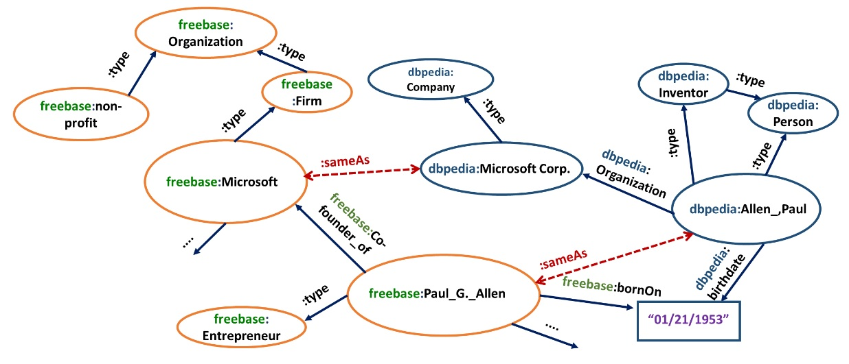
Entity Resolution (ER)
The algorithmic problem of grouping words referring to the same underlying entity

Slide 5
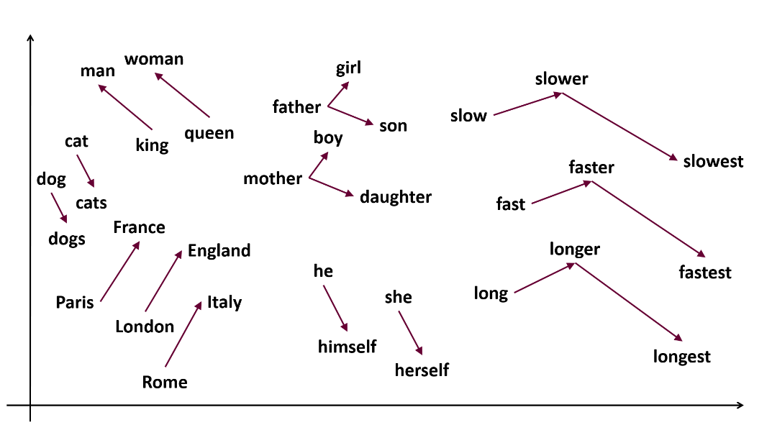
Low-dimensional vector spaces
Very popular for documents, graphs, words...

Slide 6
Some more intuition
Embeddings are not a ‘new’ invention...topic models are an early example still widely used!

Slide 7
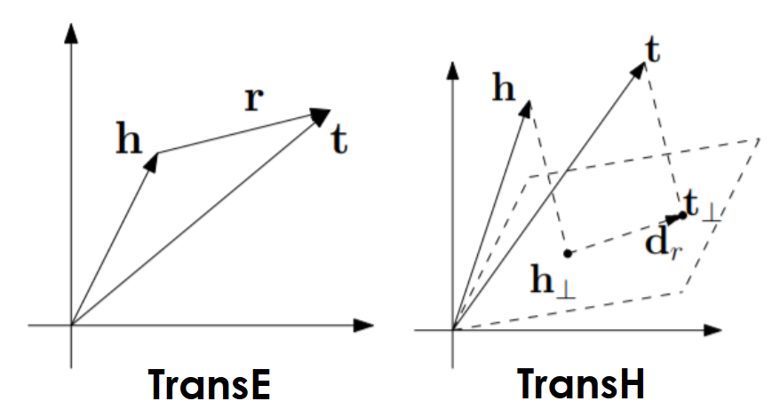
Knowledge graph embeddings
Info is converted in the form of triplet <h,r,t>
h is head, r is relation, t is Tail
Our Aim is to find any one given the other 2

Slide 8
Current KG Embedding Approaches
Focused on embedding mono lingual triples (h, r, t)

Slide 9
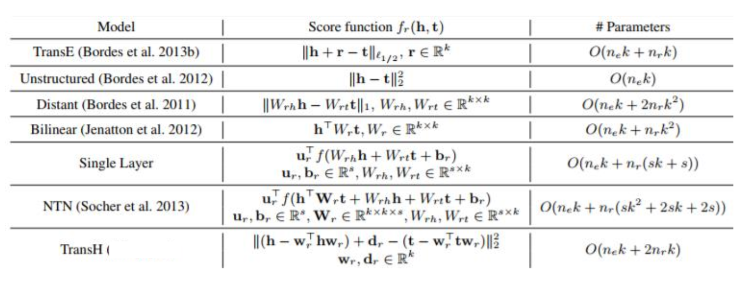
Objective/loss/energy functions
What is an ‘optimal’ vector/matrix for an entity or relation?

Slide 10
DBpedia: A Nucleus for a Web of Open Data
extract structured information from Wikipedia
make this information available on the Web under an open license
interlink the DBpedia dataset with other datasets on the Web

Slide 11
Outline:
Extracting Structured Information from Wikipedia
The DBpedia Dataset
Accessing the DBpedia Dataset over the Web
Use Cases:
Improving Wikipedia Search
Royalty-Free Data Source for other Applications
Nucleus for the Emerging Web of Data

Slide 12
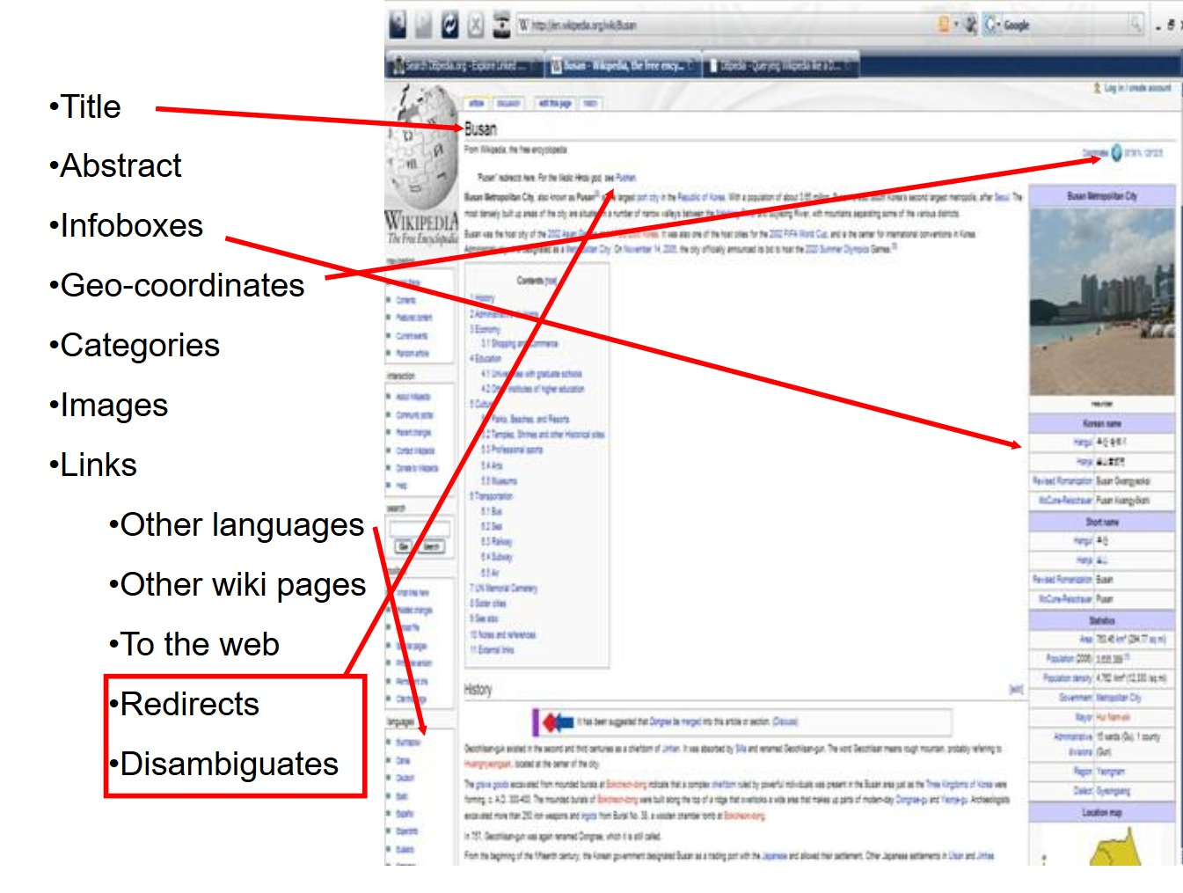

Slide 14
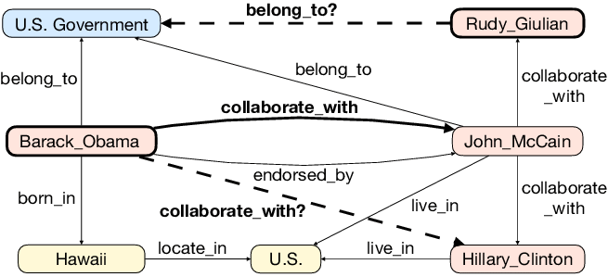
Complete Vs Incomplete KG
Example of an incomplete knowledge graph which contains missing links (dashed lines) that can possibly be inferred from existing facts (solid lines).

Slide 15
Aim of our project
Complete triple <Ameen Sayani, residence, ? > where Ameen Sayani is absent from the KG.
Desciption we have :“... Ameen Sayani was introduced to All India Radio, Bombay, by his brother Hamid Sayani. Ameen participated in English programmes there for ten years ...”.

Slide 16
KG Models: ConMask
open-world KGC model
Uses relationship-dependent content masking to reduce noise
Uses fully convolutional neural networks (FCN) to fuse related text into a relationship-dependent entity embedding.
ConMask can generate representations for unseen entities if they share the same vocabulary with entities seen during training.

Slide 17
Definitions required
e is an entity, r is some relationship,
Functions Phi(e) and Xi(e) are the description and name mapping functions
As is the description matrix of e in which each row represents a k dimensional embedding for a word in Phi(e).
As is the name matrix of r in which each row represents a k dimensional embedding for a word in the title of relationship Xi(r)

Slide 18
Feature Extraction
Maximal Word-Relationship Similarly (MWRW)
Maximal Context-Relationship Similarly (MCRW)

Slide 19
Math behind MCRW MWRW
fw calculates the masking weight for each row
we improve the content masking by using Maximal Context-Relationship Weights (MCRW) to adjust the weights of each word based on its context

Slide 20
Contents in ConMask
Embedding Lookup : Vector with all the words seems related.Words can be either entity or relation
Content Masking : Def
Target Fusion : distills an embedding using the output of which is the formal definition of relationship dependent content masking
Semantic Averaging : combines word embeddings to represent entity names and for generating background representations of other textual features

Slide 21
Content Masking & Target Fusion
Shows the overall architecture of the target fusion process and its dependent content masking process.
3 FCN layer In each layer ,first use two 1-D convolution operators to perform affine transformation.
Activation function : sigmoid
Uses batch normalization and max-pooling.
The last FCN layer uses mean-pooling so output of the target fusion layer return a single k-dim embedding.

Slide 22
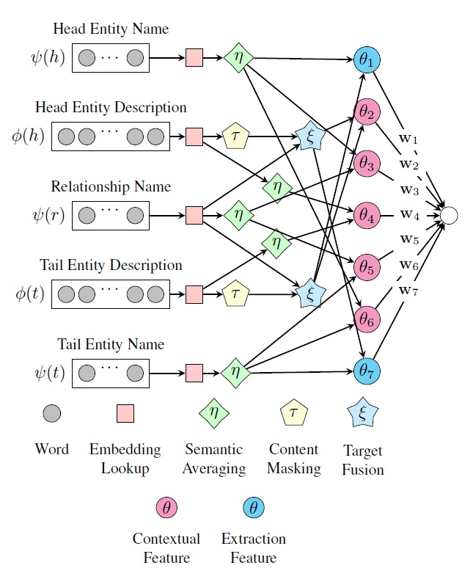
ConMask : FCN
ConMask that uses primarily text features to learn entity and relationship embeddings.

Slide 23
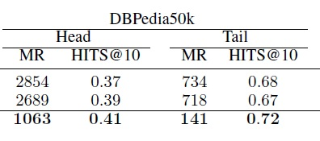
Settings
K = 200
Maximum enitity content Kc = Kn = 512
Km = 6
Kfcn = 3
Drop out and keep probability = 0.5
The minibatch size Kb= 200
Optimizer Adam with a learning rate of 1/100
No of epochs = 200

Slide 24
KG Models: SimplE
Takes 2 vectors as the embedding of each entity e
Another 2 vectors for each relation r
The similarity function is
Its the average of the Canonical Polyadic scores for

Slide 25
Learning SimplE Models
Uses Stoch. gradient descent with minibatches
optimize the L2 regularized negative log-likelihood of the batch
l represents the label of a triple
represents the similarity score for the triple <h,r,t>
lambda is the regularization hyperparameter
And
Note : margin-based loss function overfit hence log function

Slide 26
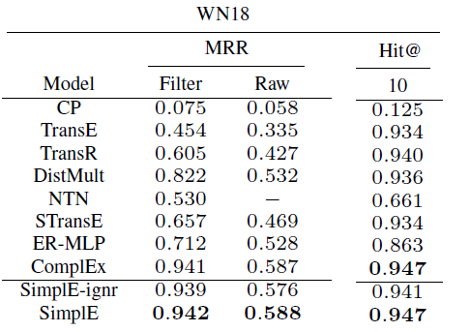
Result And Conclusion
Simple is really good model in Open KG

Slide 27
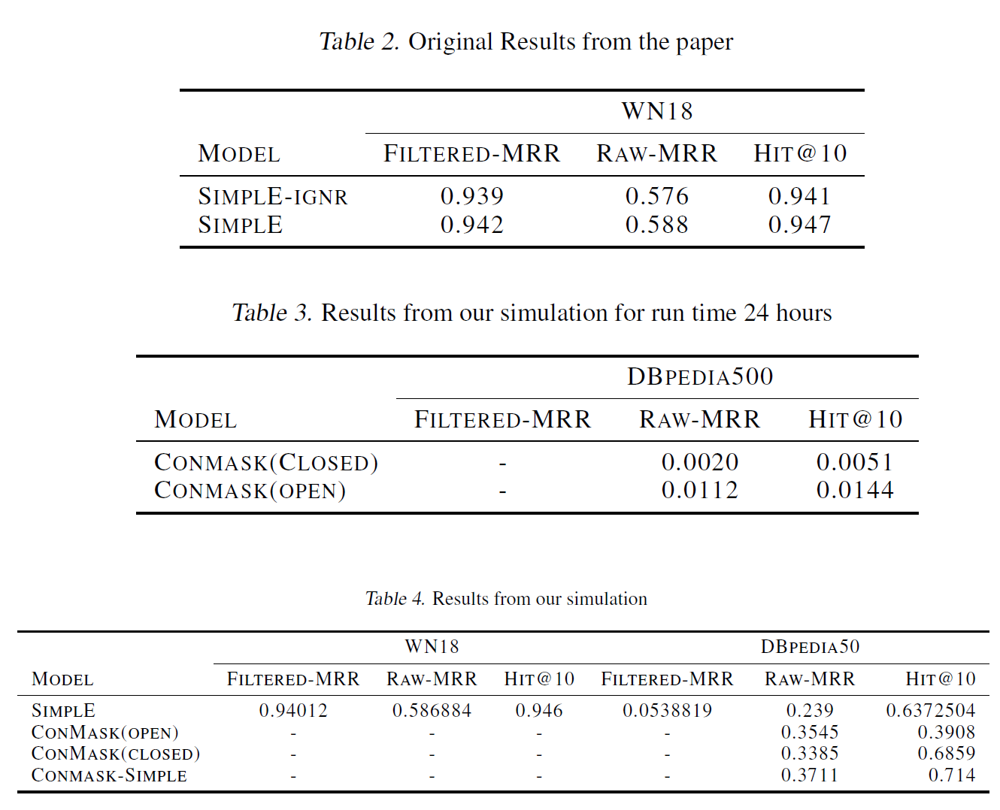
Rerunning Simple and ConMask

Slide 28
Comparison of Conmask Vs Simple
Adam Optimizer
Sum(-W*log(Softmax(h,r,t)) where W is the ration of cardinality of entity embedding
Product of score of entity
AdaGrad
Loss fn : head^2 + tail^2 + rel^2+ invrel^2 /2
Average of score of triplet with relation and its inverse

Slide 29
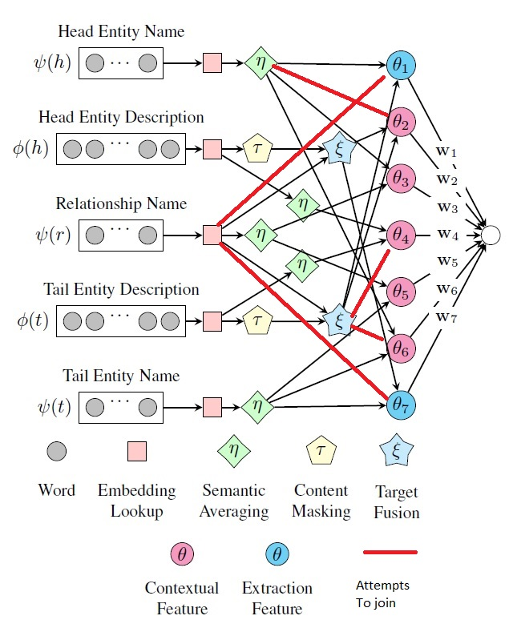
Things we attempted And failed
Changing the below FCN by adding another connections
Seems there is a logic behind the connection its better not to mess with it
Raw MRR And Hit@10
0.29 -0.32 0.20 - 0.38

